Slide 1
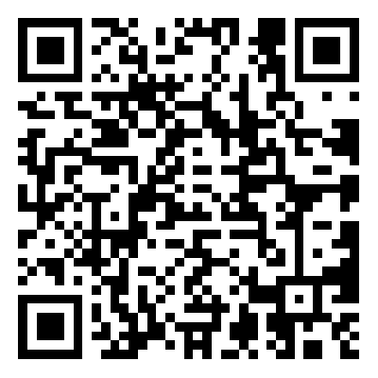
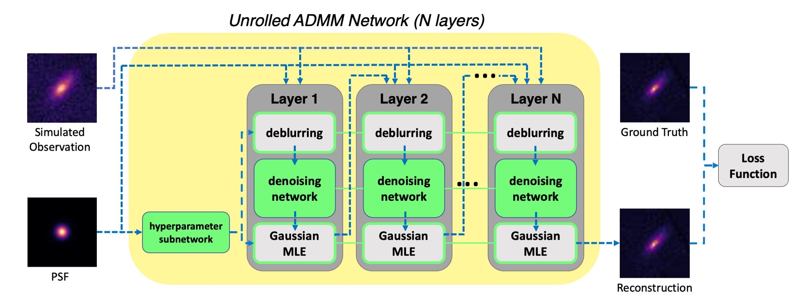
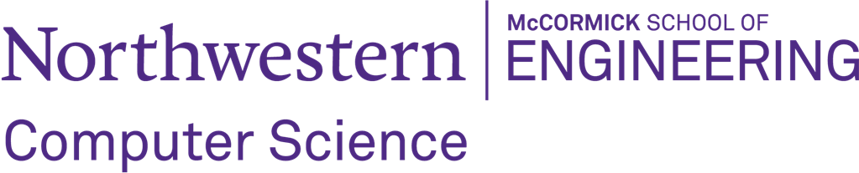

Research internship: Galaxy Image Deblurring
Desired Skills and Background: Signal processing, Computer Vision, and Machine learning
Your responsibilities in this project: 1. Reading and presenting research papers. 2. Developing code and conducting experiments. 3. Benchmarking results and summarizing key findings.
We are looking for undergrad/master's students in the US with an interest in computational imaging/computer vision and availability to work through the summer. You will work for at least 10 hours/week and receive mentorship throughout the project. If you are an undergrad at Northwestern, we could fund you through the CS UG Summer Research Grant (deadline May 17th). Please reach out to us (tianaoli@u.northwestern.edu) and fill out this form if you are interested.
Galaxy images captured by telescopes are degraded by nonidealities in the atmosphere, optics, and sensors. Even the most advanced telescopes produce blurs in those images, which significantly hinders our ability to discern the true shapes and structures of these galaxies. We previously addressed this challenge by developing a physics-informed deep learning method to deblur galaxy images for the Rubin Observatory (LSST), enabling more accurate shape measurements for weak lensing studies (more details here). This project pivots to address galaxies observed by space-based telescopes (e.g. JWST), where the absence of atmospheric distortion allows for high-resolution imaging for galaxy morphology studies. Our goal is to submit our discoveries to an astrophysical journal.

